Slide 1
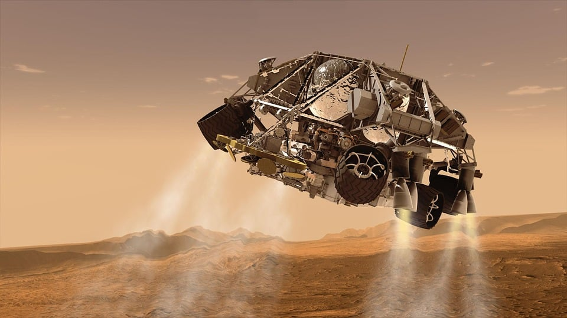
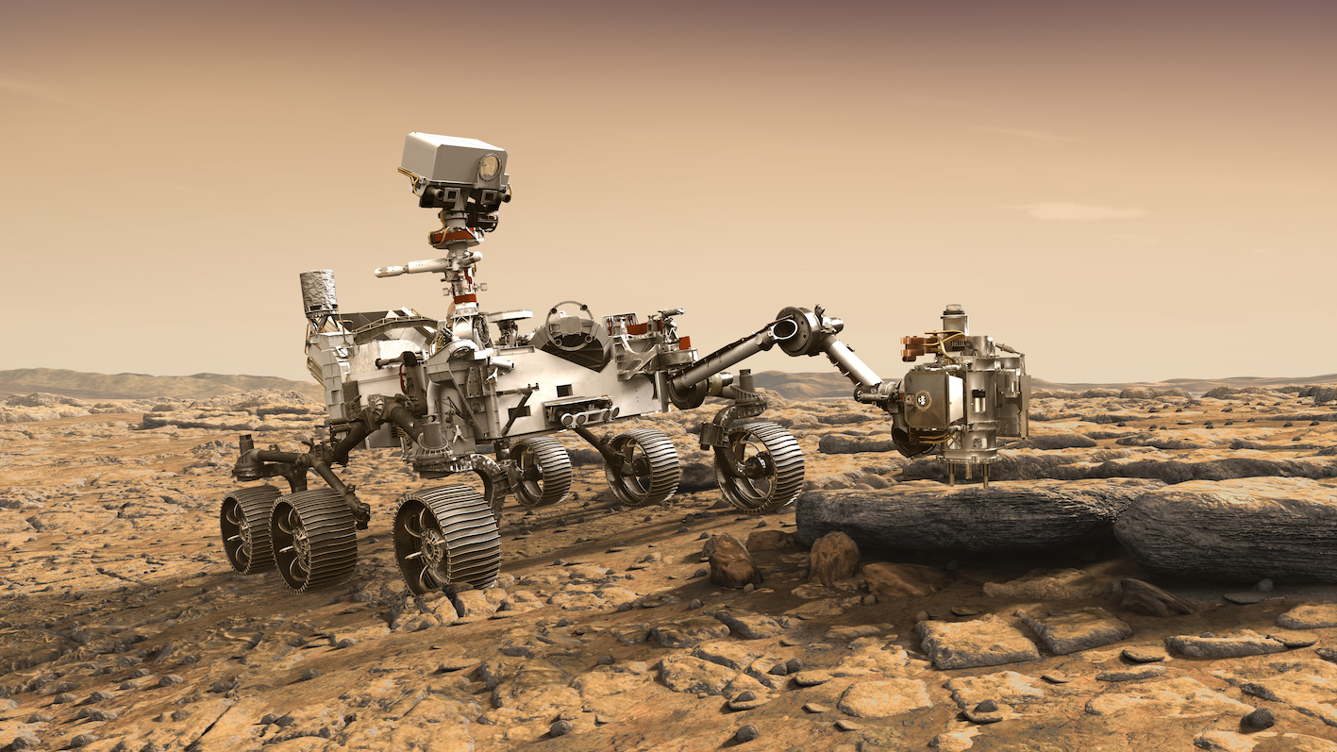
Intro to CAD
Mission to Mars

Slide 2
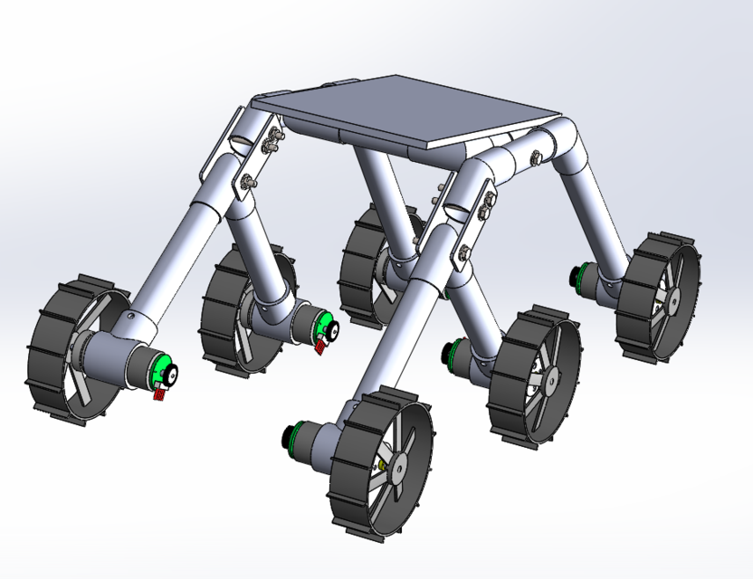
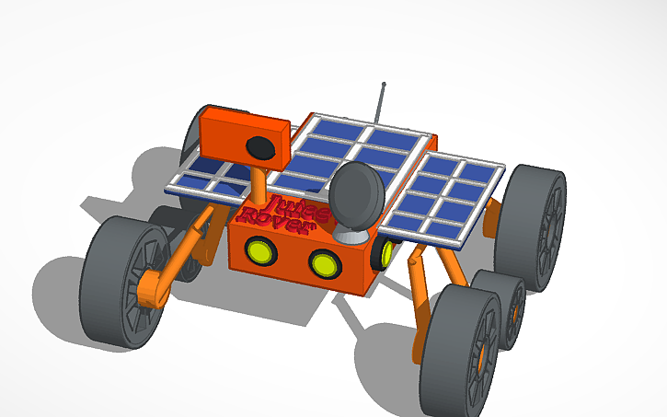
Why use CAD for Robotics?
Planning
Sketching
Assemblies
Design principles validation
Establishing Priorities

Slide 3
Planning
Ensure your robot fit in the Size needed
mechanisms fit
Everyone is on the same page
Refer to CAD to build things
Integration and compatibility of everything
Be able to optimize custom designed parts, 3D printed, CNCed, or Laser Cut
Have separate mechanism integrate together well
Maintain Functional Integrity
Calculate Center of Gravity (COG)
Terrain Aware

Slide 4
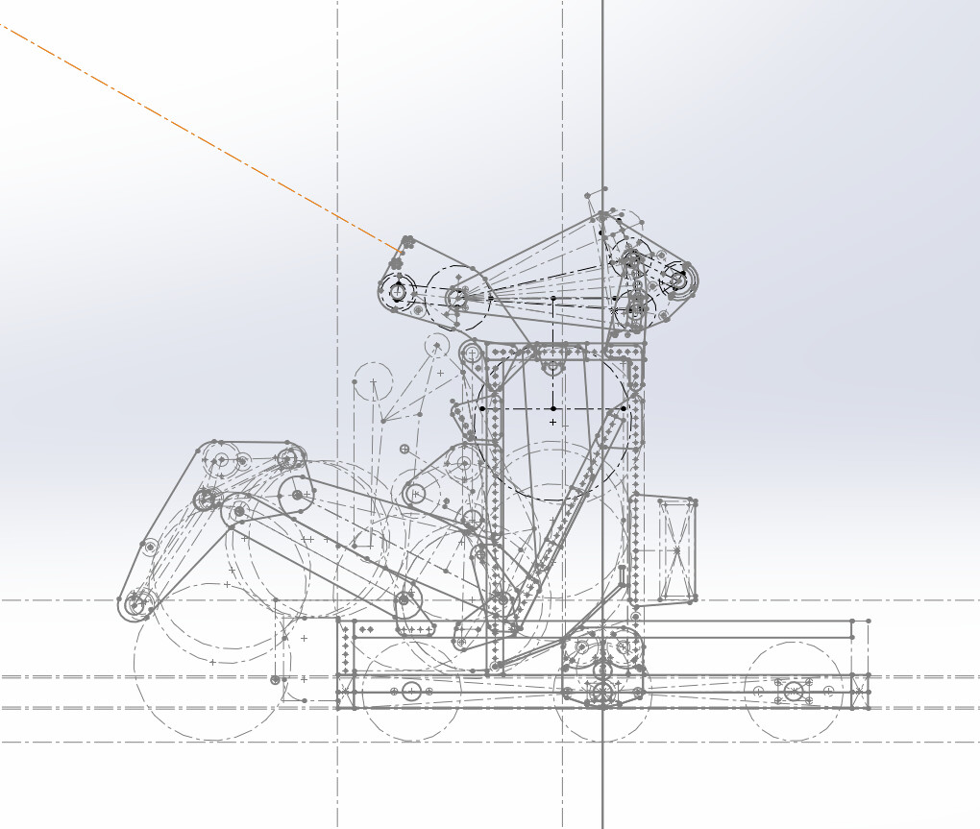
Sketching – Mastering Geometry
Sketch out important field elements
Extended Positions
Path of game piece
Starting Configuration

Slide 5
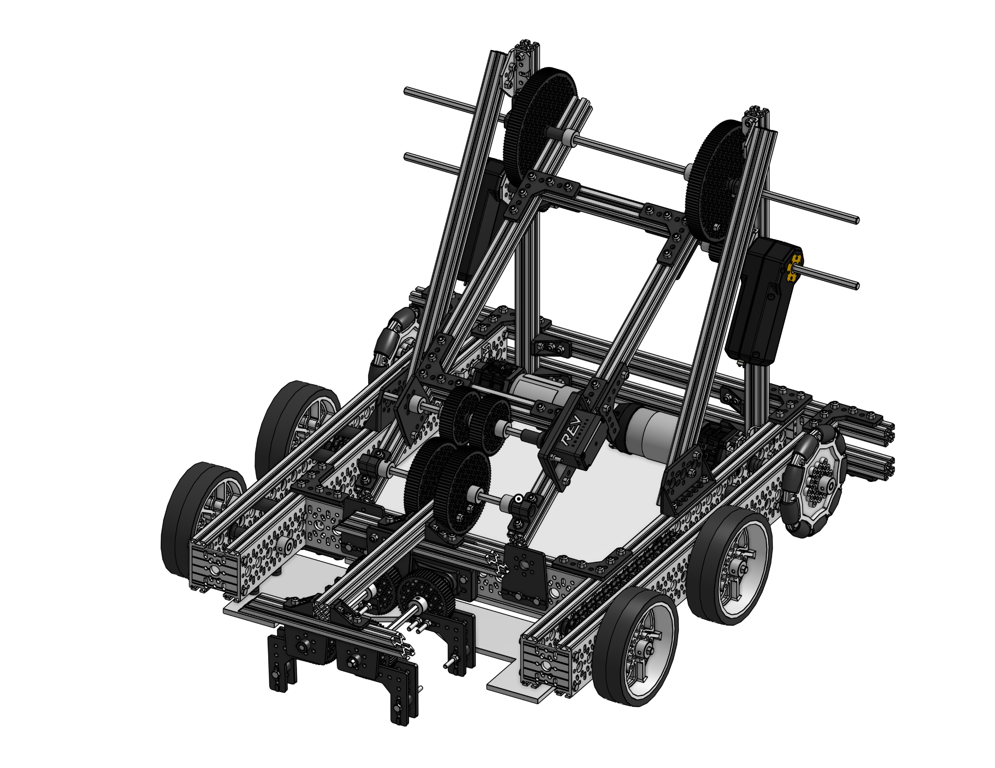
Assembly
Build your robot virtually
Ensure everything fits
Good visual guide
Keep things simple
For the betterment of your computers
Bolts and spacers should be implied
Potential Simulation of the Robot
rotational /sliding mates can be used so you can rotate/extend arm/slide in CAD

Slide 6
CAD Workshop

Slide 7

CAD Options
Onshape
Autodesk - Fusion 360
Autodesk - Inventor
Sketchup
Autodesk - Tinkercad
Notes:
Tinkercad for elementary and middle school students
Onshape for professional designers.

Slide 8
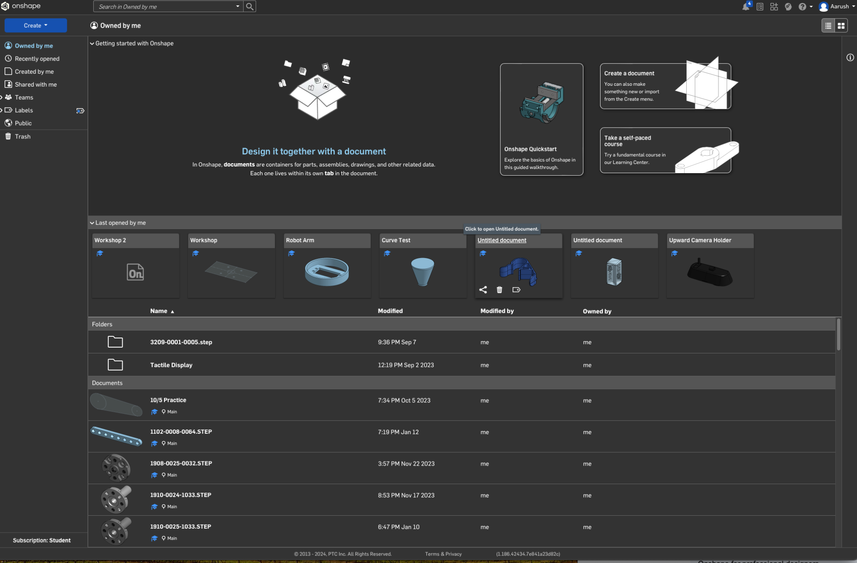
Onshape Documents
Create
Other navigation
Recent docs
Documents
Notes:
Tinkercad for elementary and middle school students
Onshape for professional designers.

Slide 9
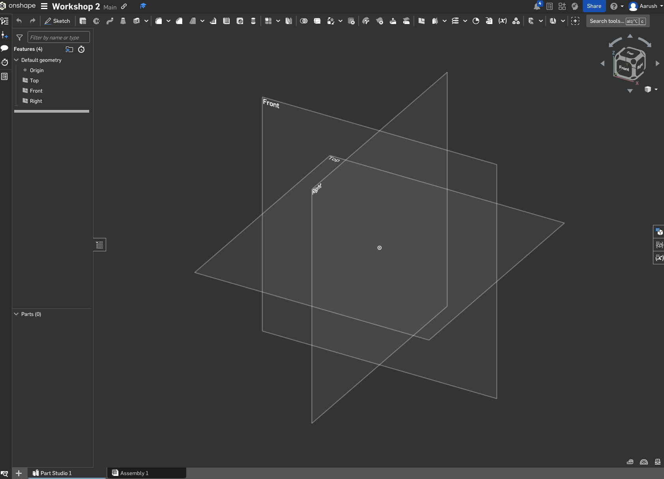
Parts Basic
Viewing Cube
Plane hiding
Origin
Planes - perpendicular to each other

Slide 10
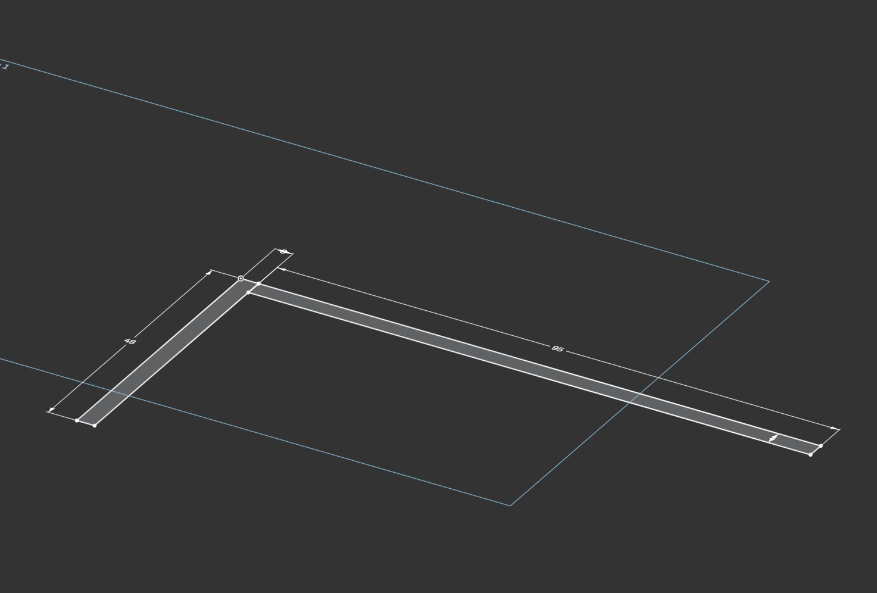
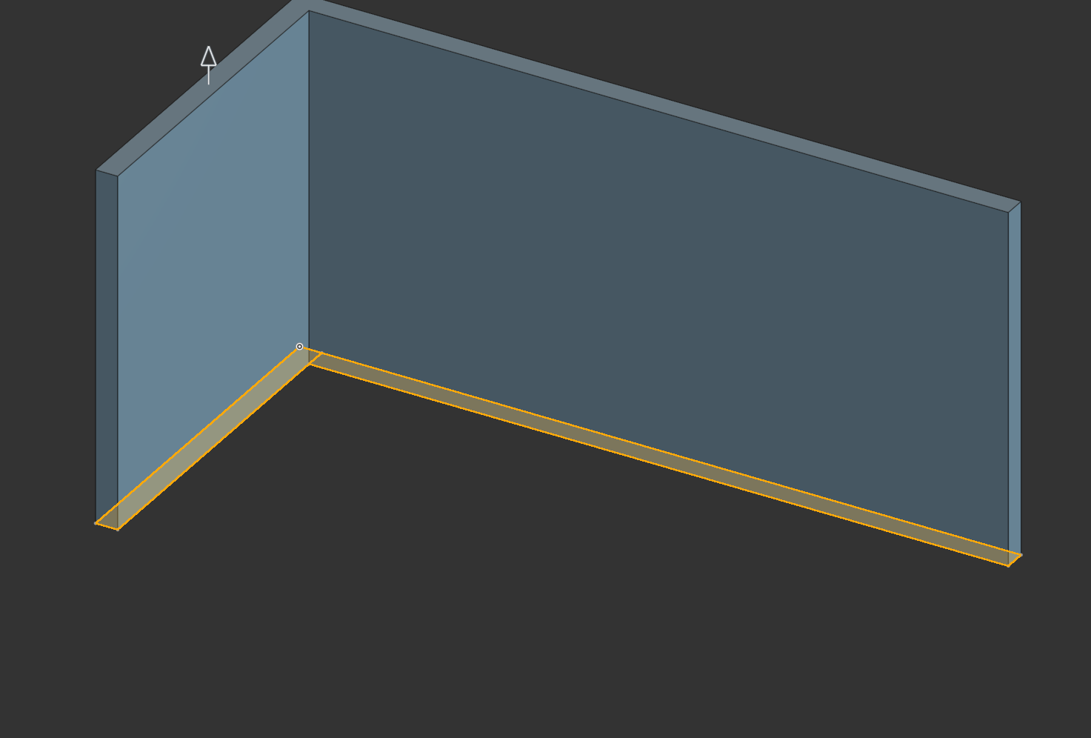
Sketch -> Extrude

Slide 11
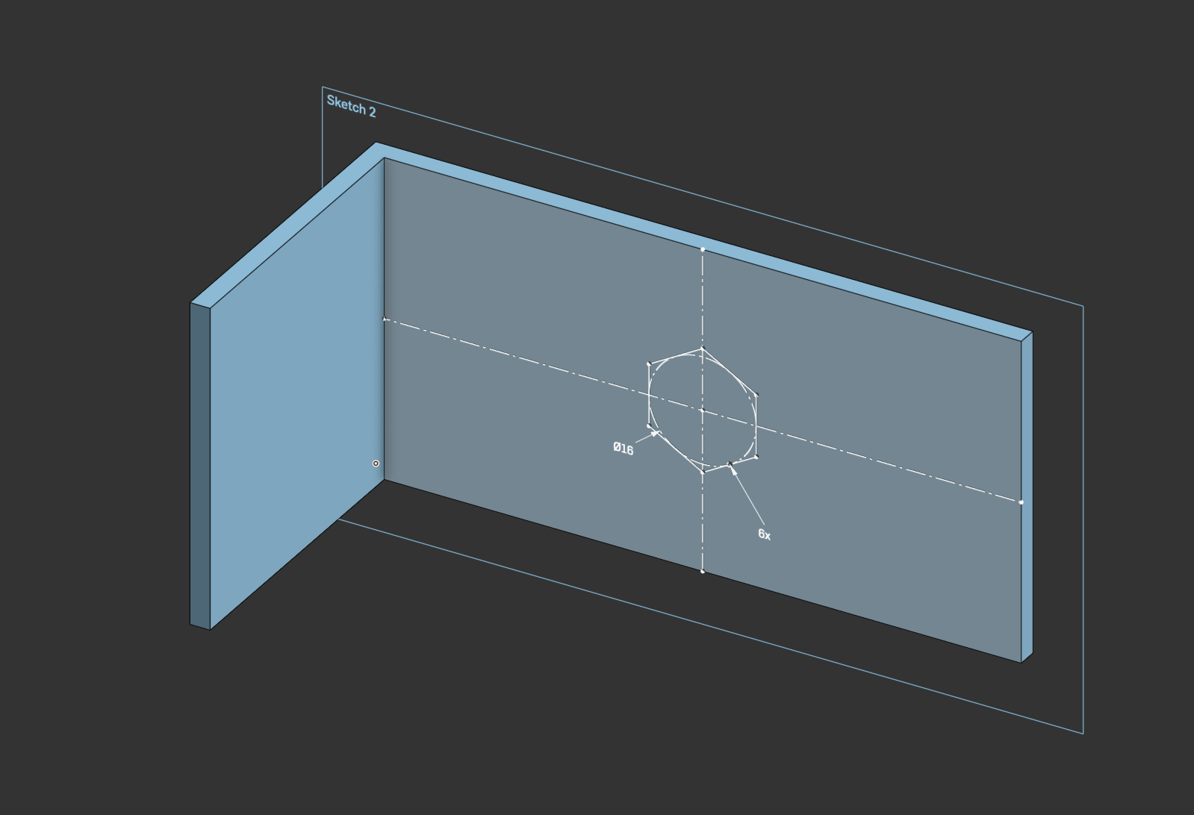
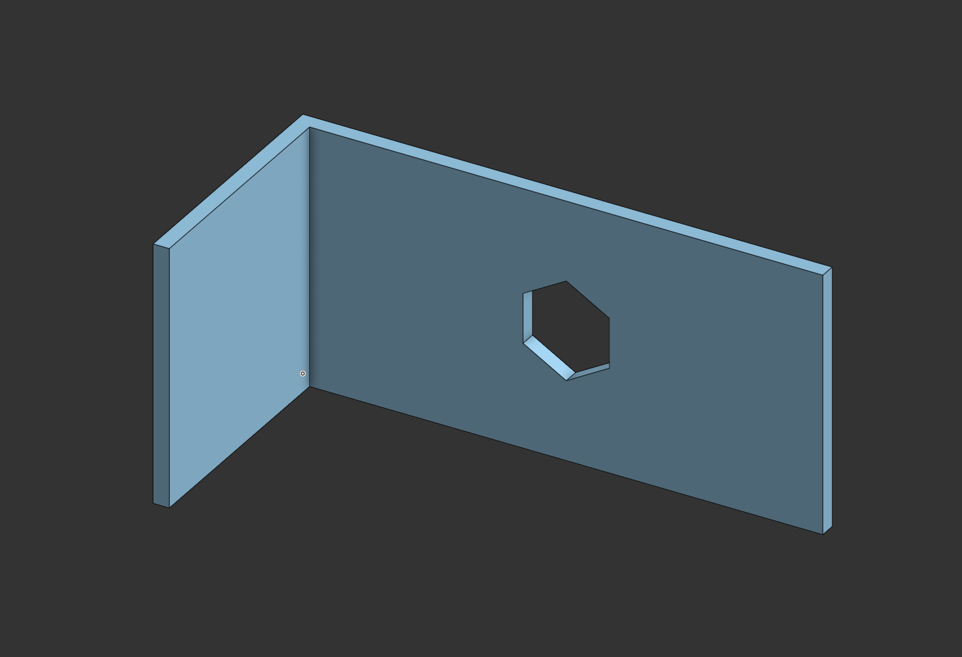
Sketch (on Face) -> Extrude (remove)

Slide 12
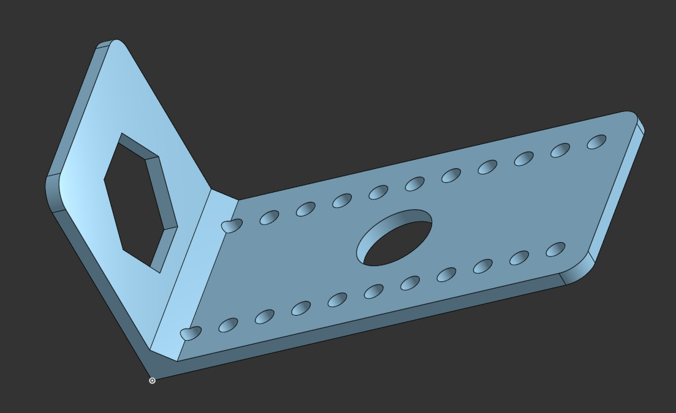
Let’s Build a Part

Slide 13
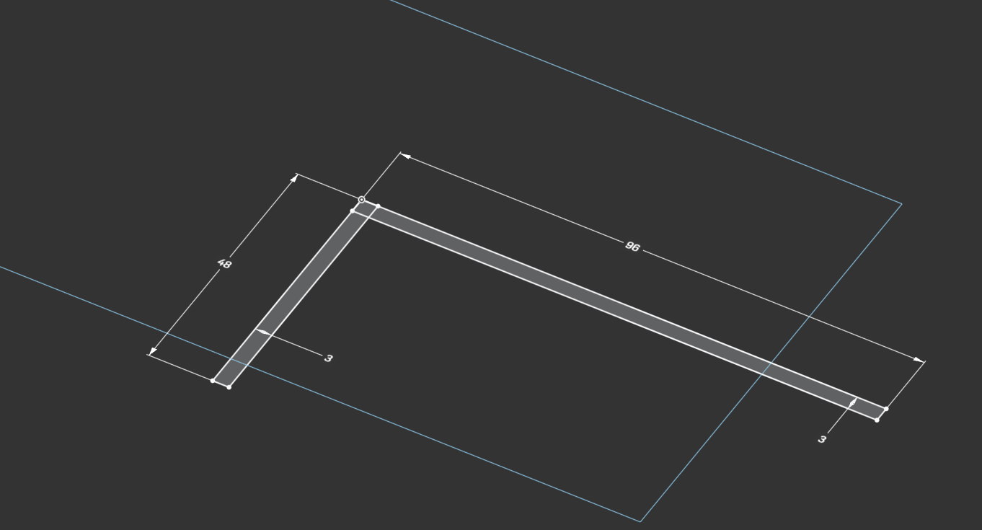
Sketch #1 - L-shape

Slide 14
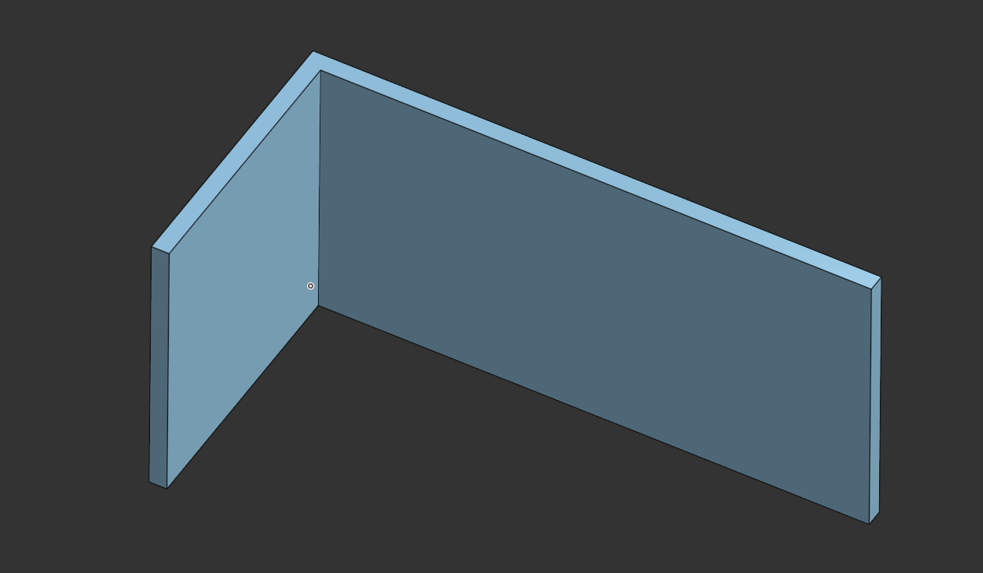
Extrude > New > 48mm

Slide 15
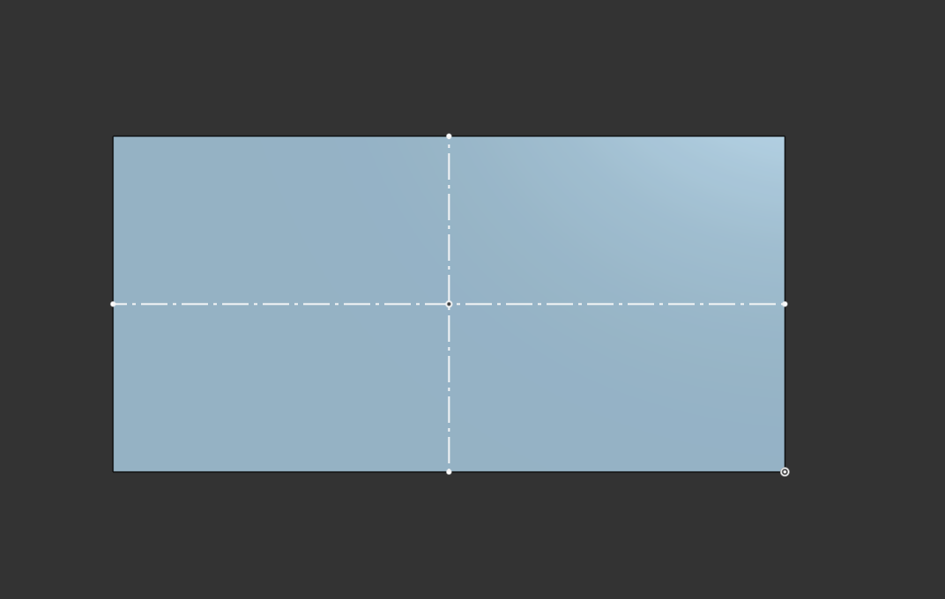
Sketch > Backside of 96mm side
Show Coincident Constraint
2 Construction Lines + Construction Point

Slide 16
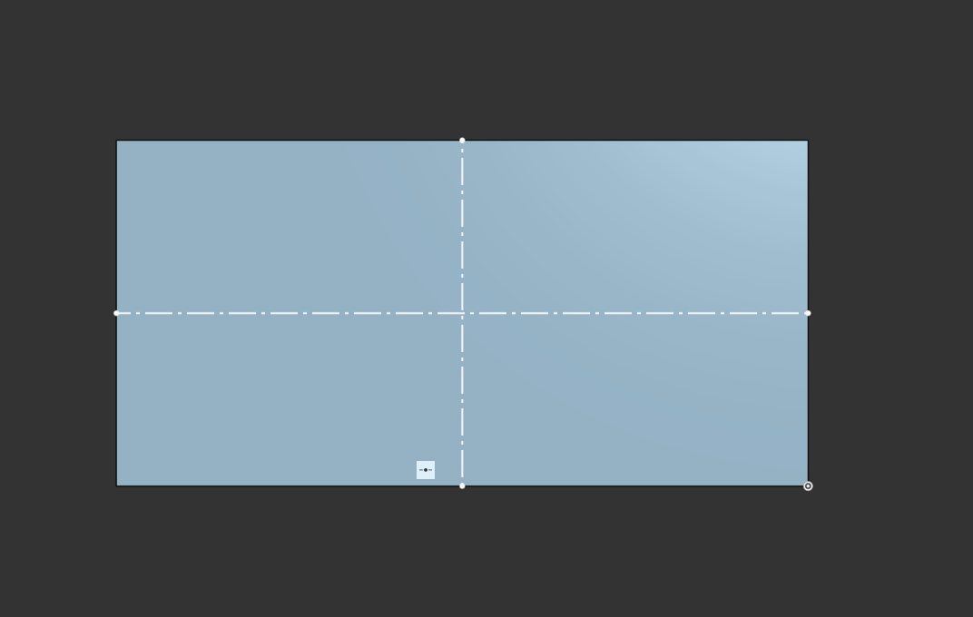
Sketch > Backside of 96mm side
2 Construction Lines
Coincident Constraint

Slide 17
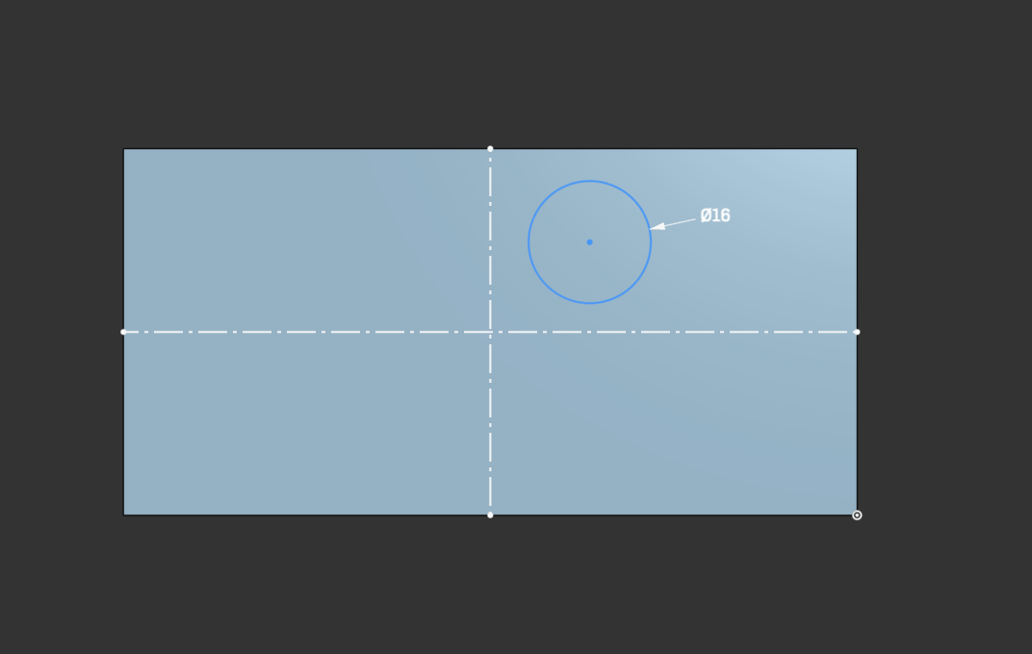
Sketch #2
Draw 16mm circle not at the center

Slide 18
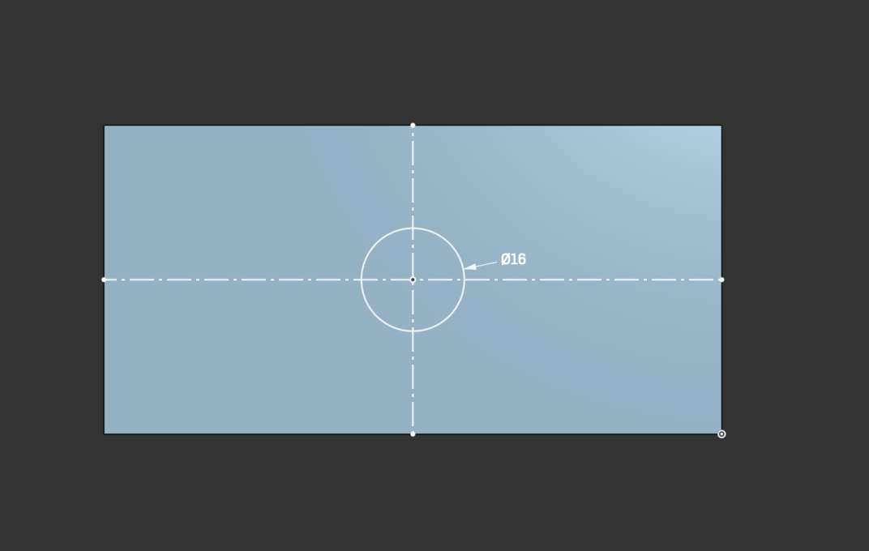
Sketch #2
Apply Coincident constraint between circle center and part center
Point out that the shape is now locked

Slide 19
Sketch #2
Apply Coincident constraint between circle center and part center
Point out that the shape is now locked

Slide 20
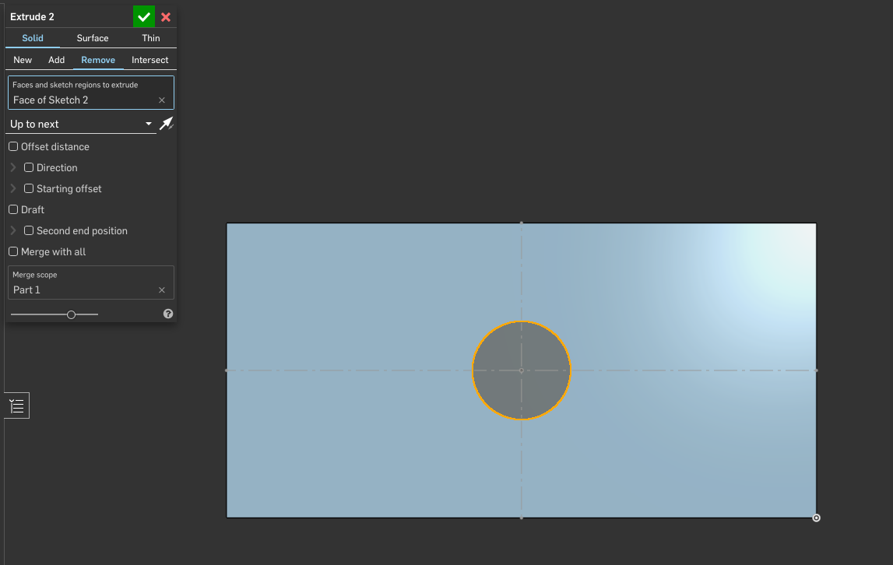
Extrude #2 > Remove > Up to next
Extrude to remove the hole in the center

Slide 21
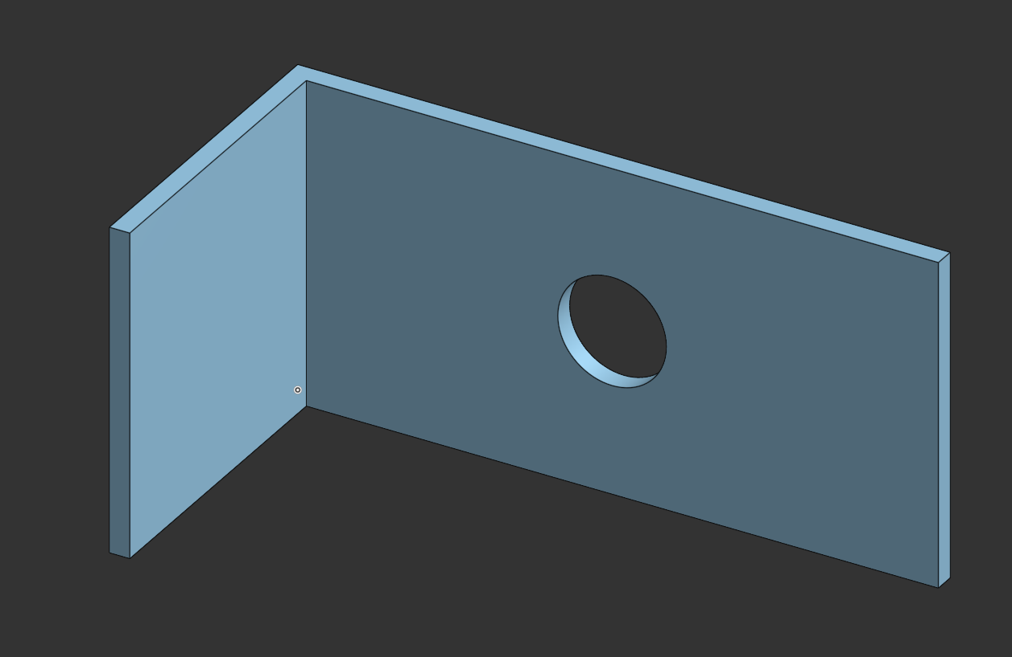
Extrude #2 > Remove
Isometric view

Slide 22
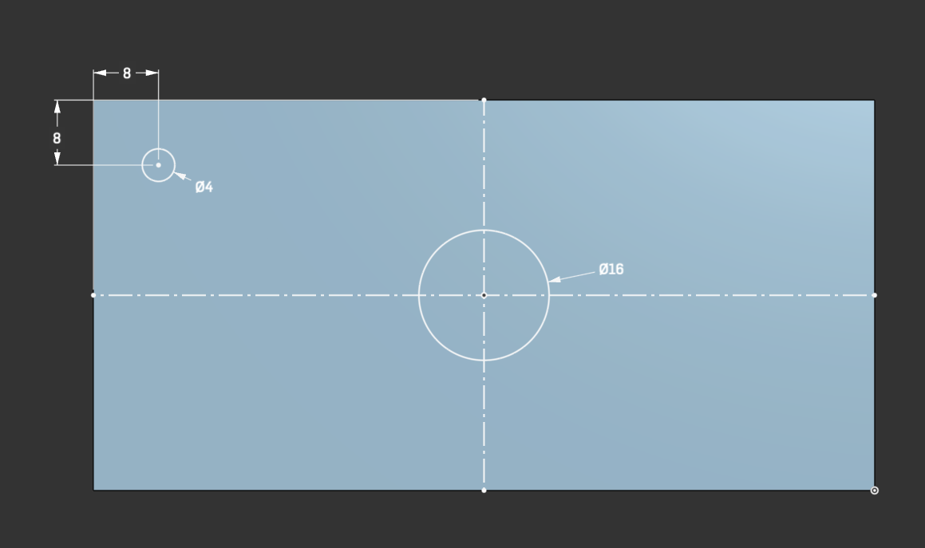
Sketch #2 > Dimension Constraint
Create 4mm circle
Lock to 8mm from closest edges
Point out that the shape is locked

Slide 23
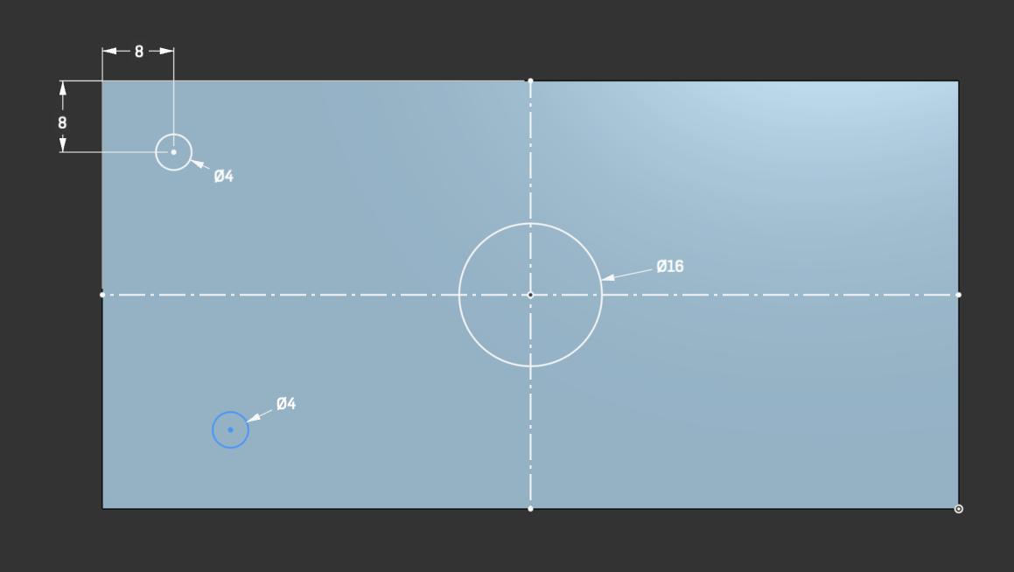
Sketch > Vertical Constraint
New 4mm circle

Slide 24
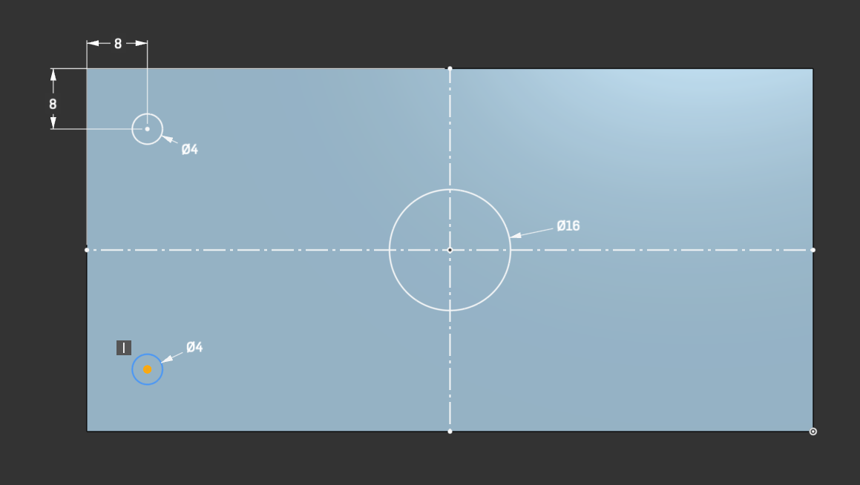
Sketch #2 > Vertical Constraint
Apply Vertical Constraint and note that the circle moved below the other circle
Still not locked

Slide 25
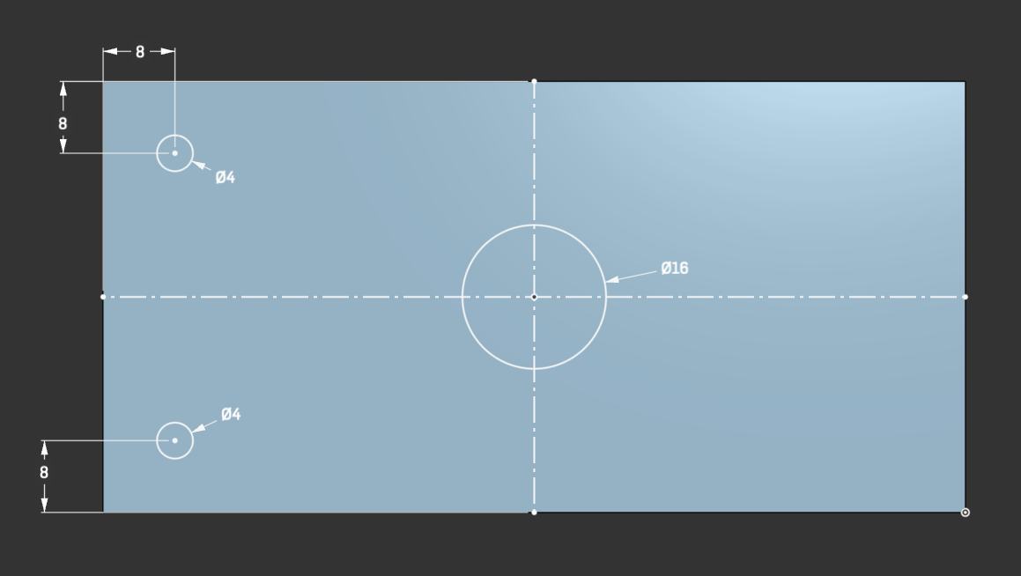
Sketch #2 > Vertical Constraint
Add dimension to lock shape

Slide 26
Sketch #2 > Mirror

Slide 27
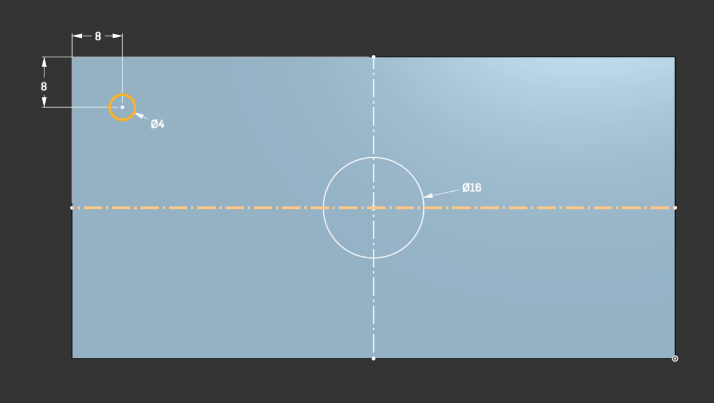
Sketch #2 > Mirror
Select Circle
Choose Mirror Tool
Select Horizontal Line

Slide 28
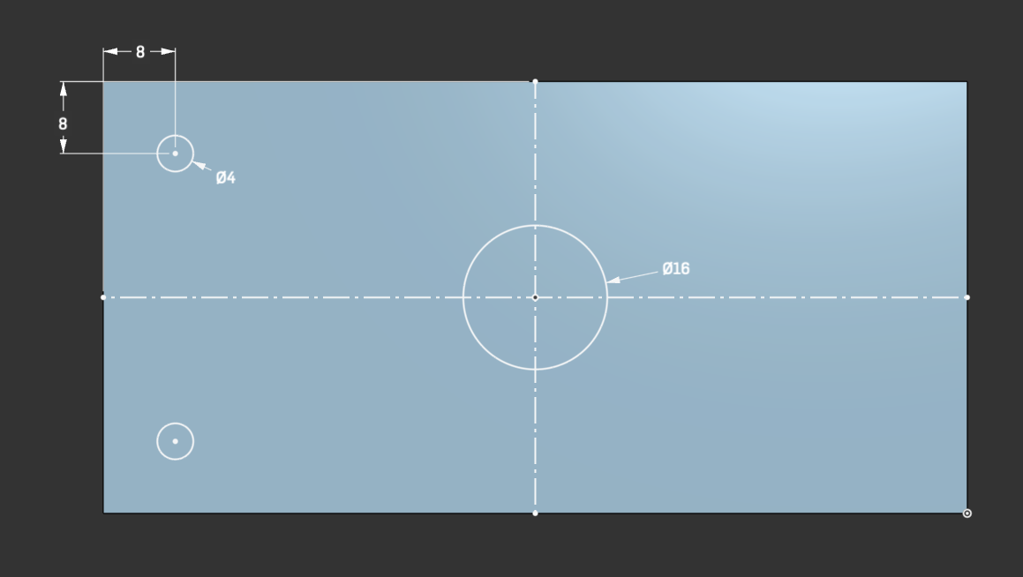
Sketch #2 > Mirror
New Hole (locked)

Slide 29
Sketch #2 > Pattern
Back to Single Hole

Slide 30

Sketch #2 > Pattern
Select hole
Choose Linear Pattern Tool

Slide 31
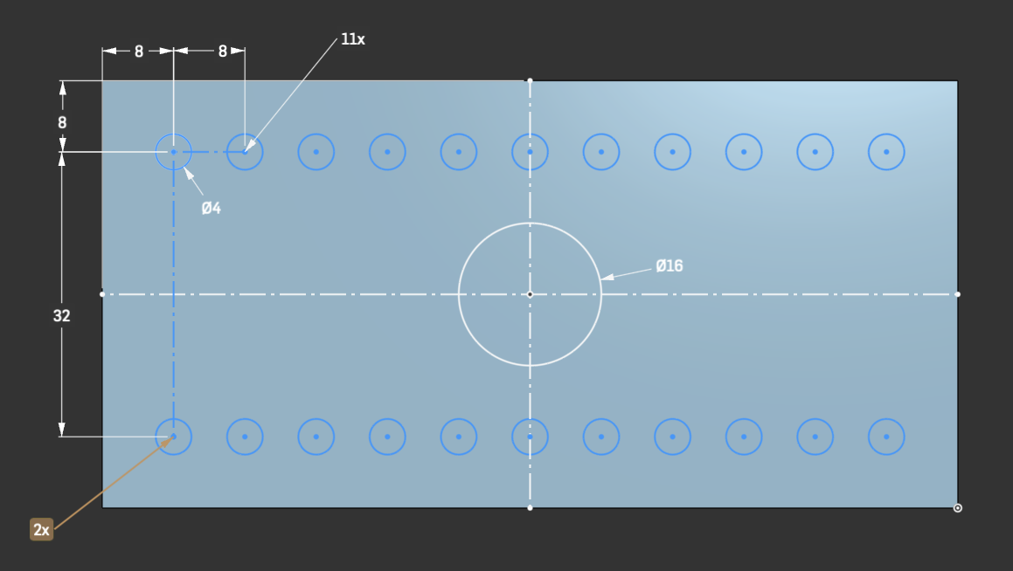
Sketch #2 > Pattern
Horizontal
11x, 8mm gap
Vertical
2x, 32mm gap

Slide 32
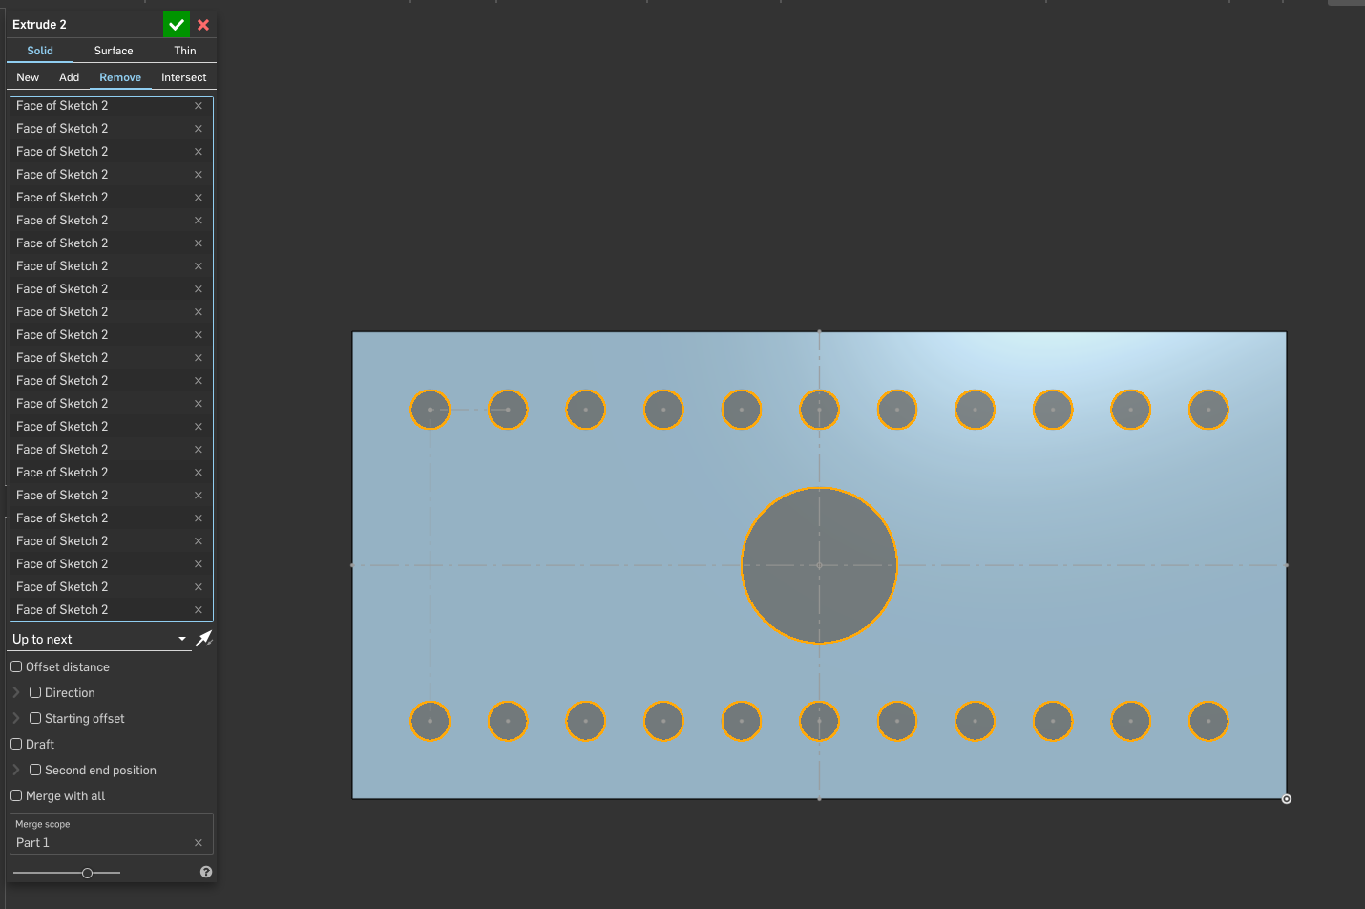
Extrude #2 > Remove holes

Slide 33
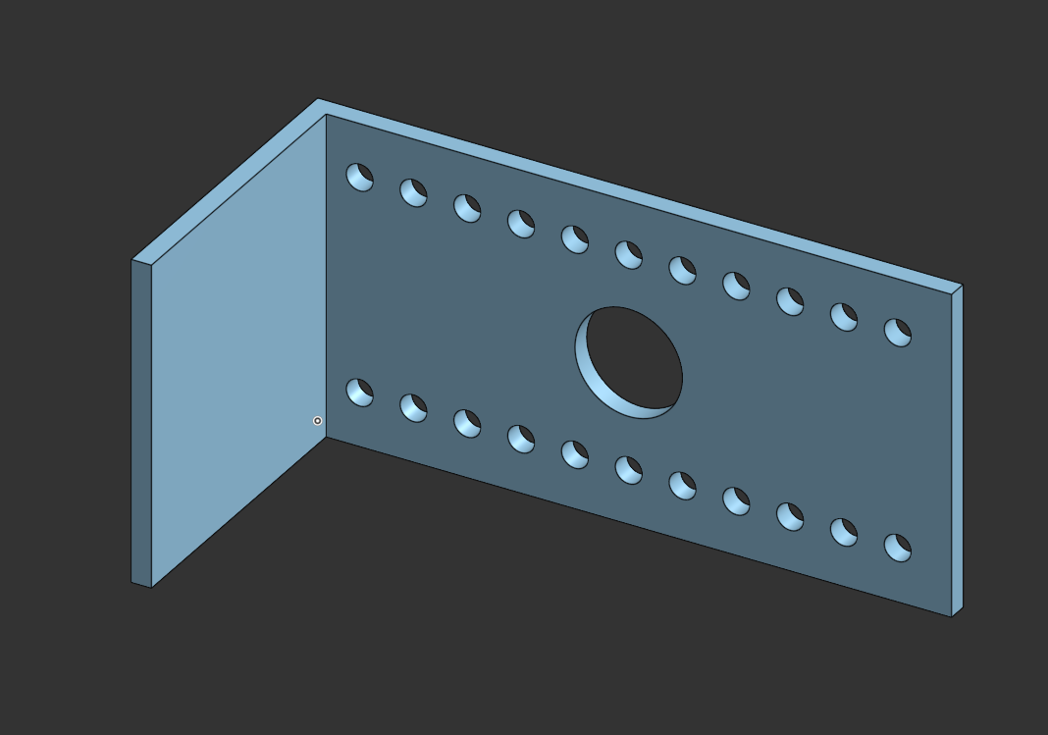
Extrude #2 > Remove holes

Slide 34
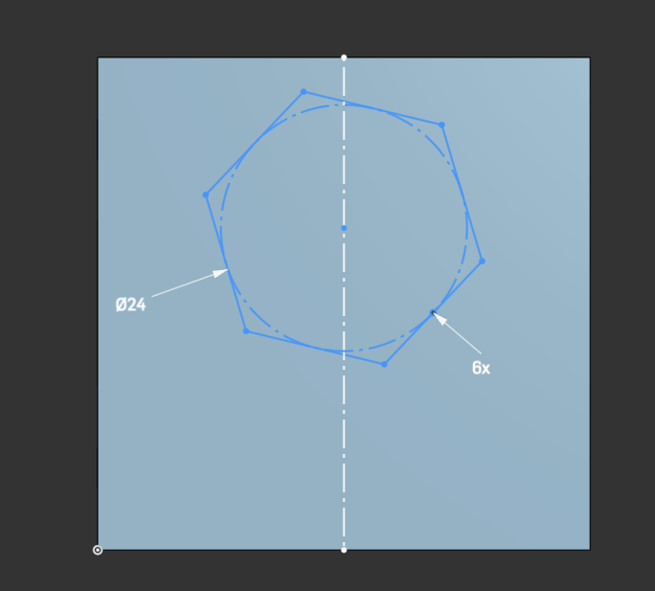
Sketch #3 > Backside of 48mm side
Add Inscribed Polygon
6 sided
24mm radius
Show other polygons were possible
Hexagon center not at center of square
Vertices also don’t line up
Construction line through center axis

Slide 35
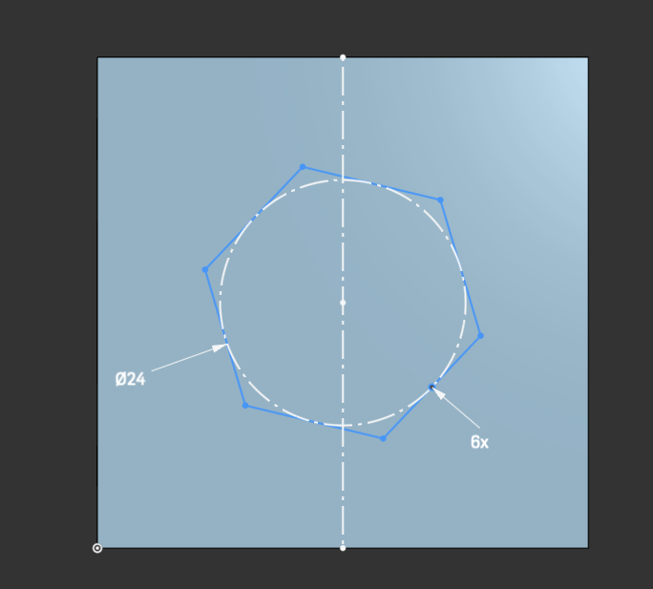
Sketch #3 > Midpoint Constraint
Click Midpoint Constraint
Select Hexagon Center
Select Construction Line
Show that the Hexagon moved to center of square

Slide 36
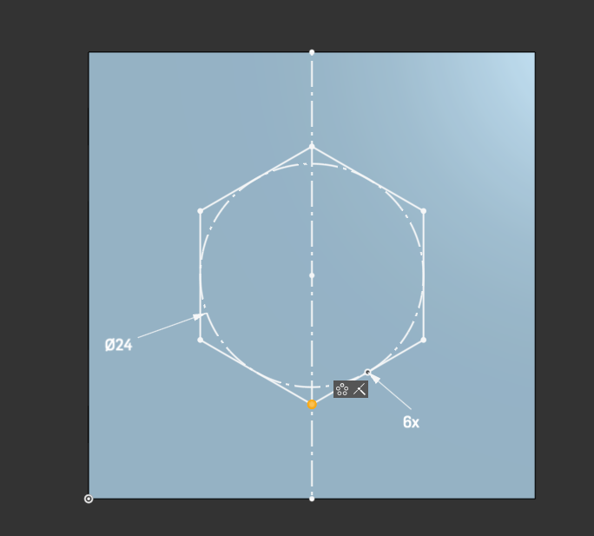
Sketch #3 > Coincident Constraint
Note that the hexagon aligns correctly
Shape is now locked
Choose Coincident Constraint
Select a vertex
Select the Line

Slide 37
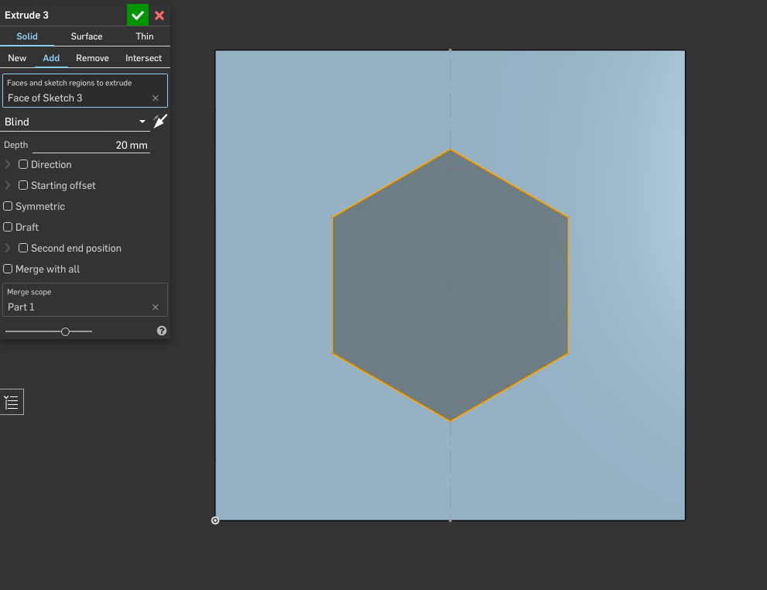
Extrude > Add > Blind > 20mm

Slide 38
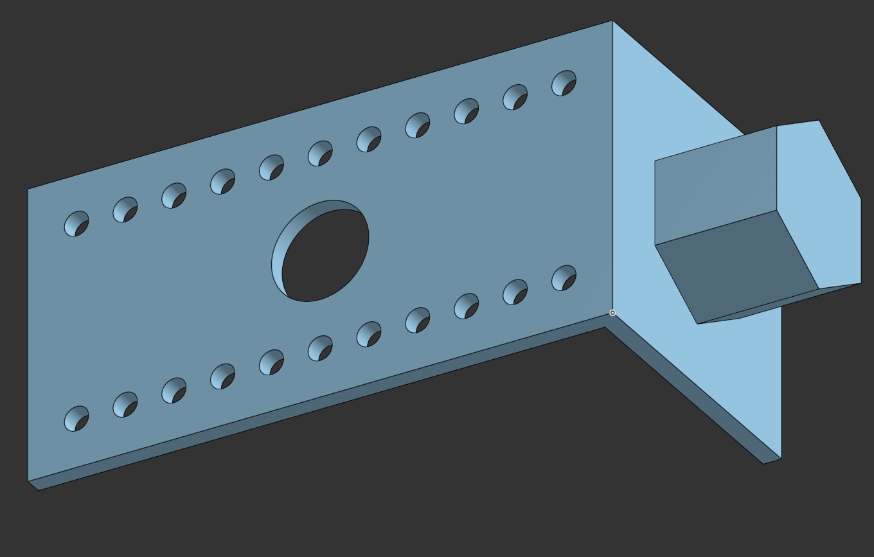
Extrude > Add > Blind > 20mm

Slide 39
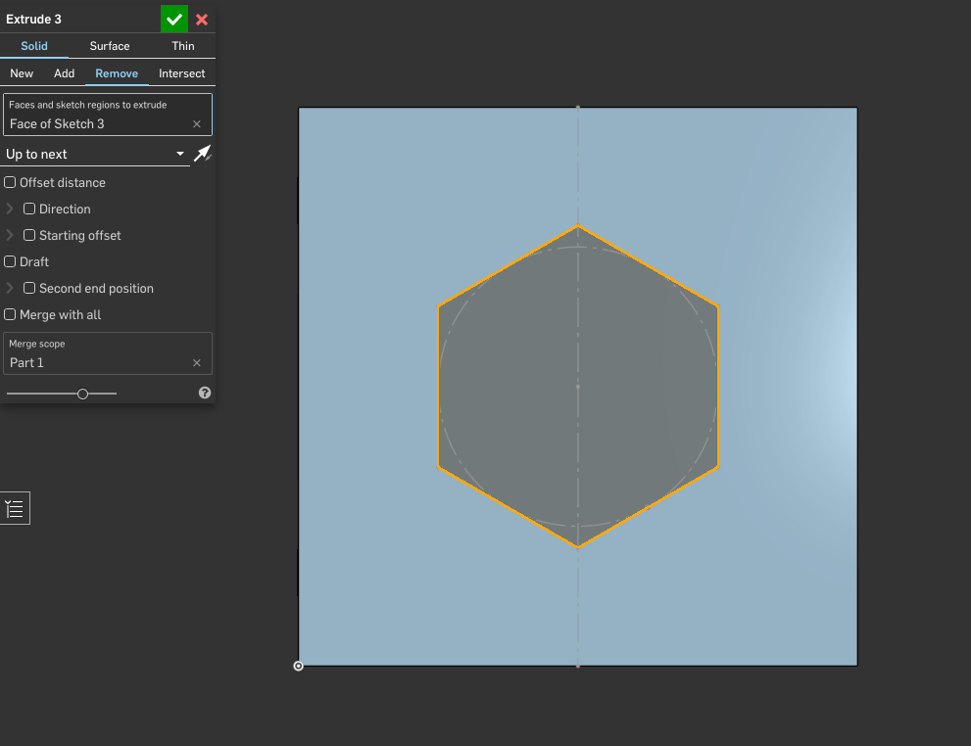
Extrude > Remove > Up to next

Slide 40
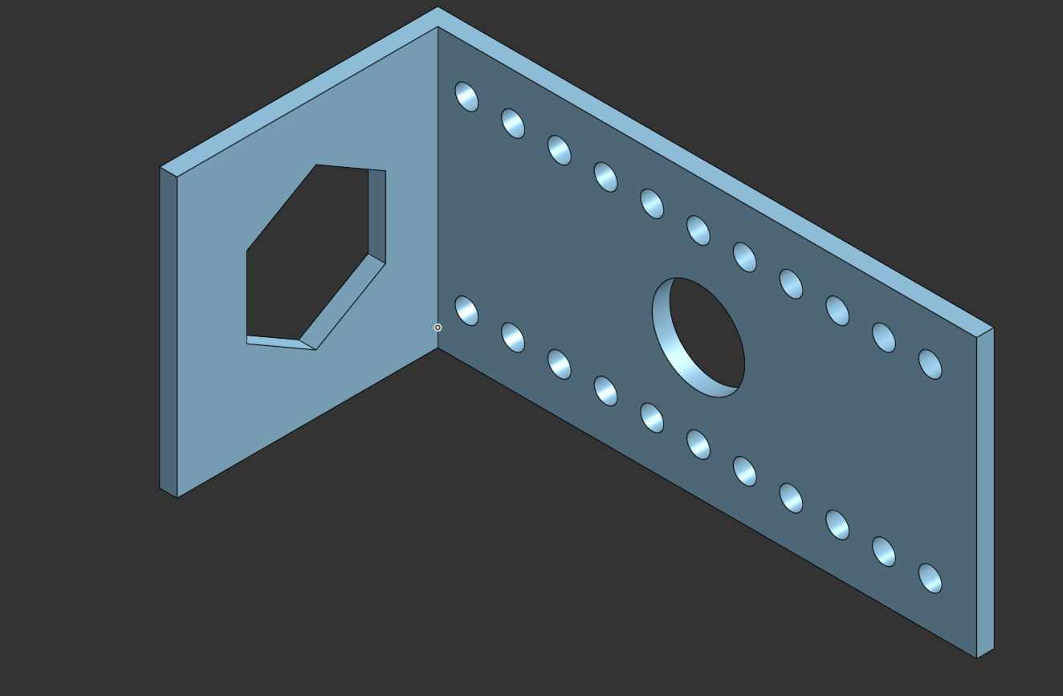
Extrude > Remove > Up to next

Slide 41
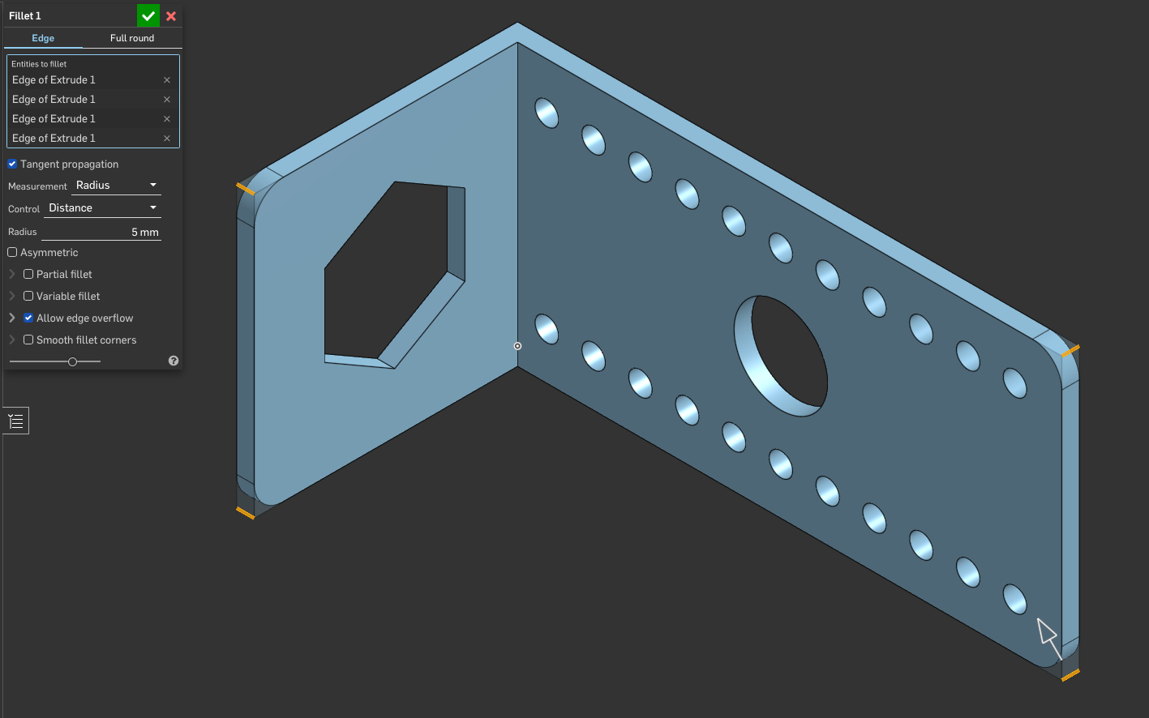
Fillet > Radius > 5mm
Choose Fillet tool
Select Edges

Slide 42
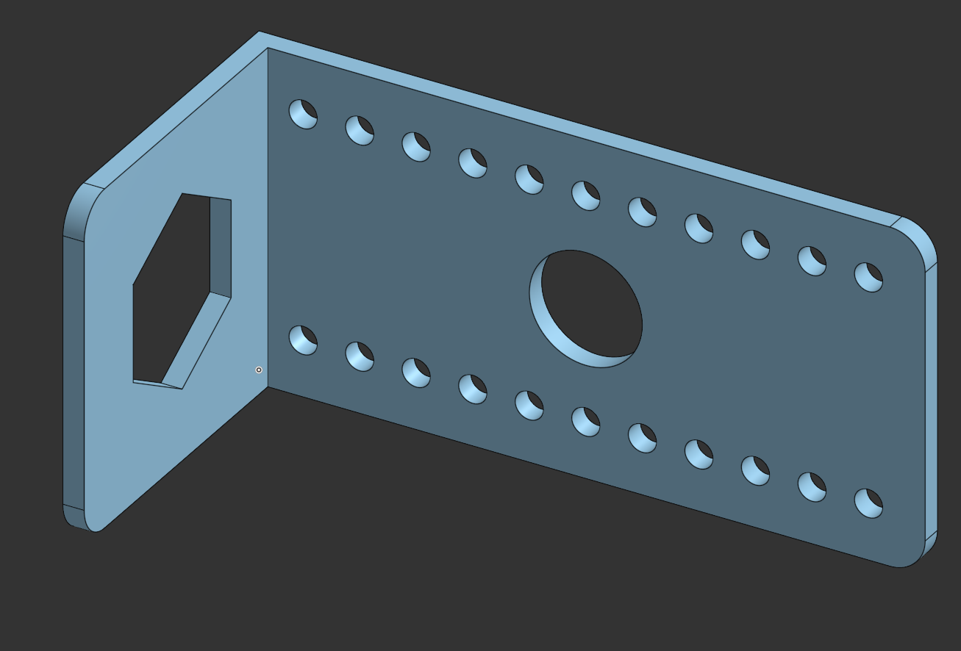
Fillet

Slide 43
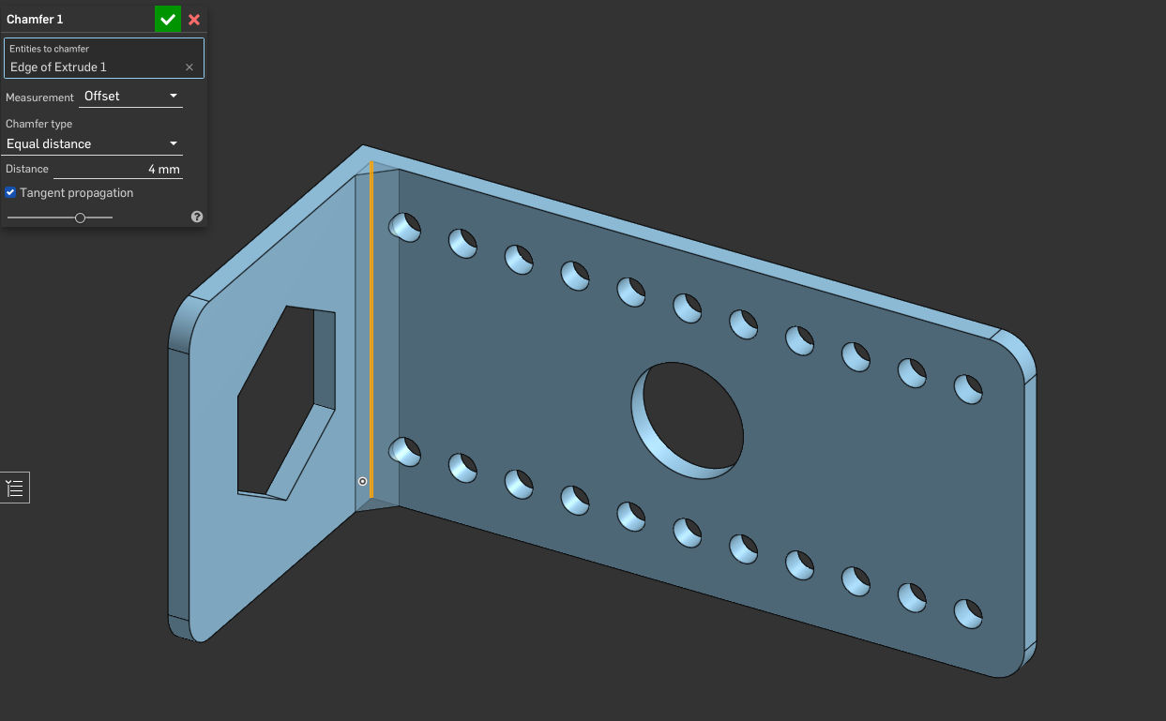
Chamfer
Choose Chamfer tool
Select Central Edge

Slide 44
Chamfer

Slide 45
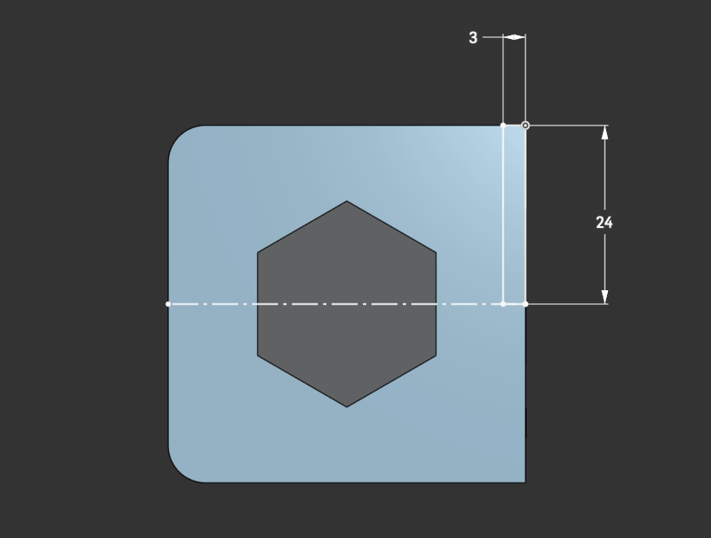
Sketch #4 > Backside of 48mm
Draw 3 x 24mm rectangle on the base side
Draw a construction line that will be our revolve axis

Slide 46
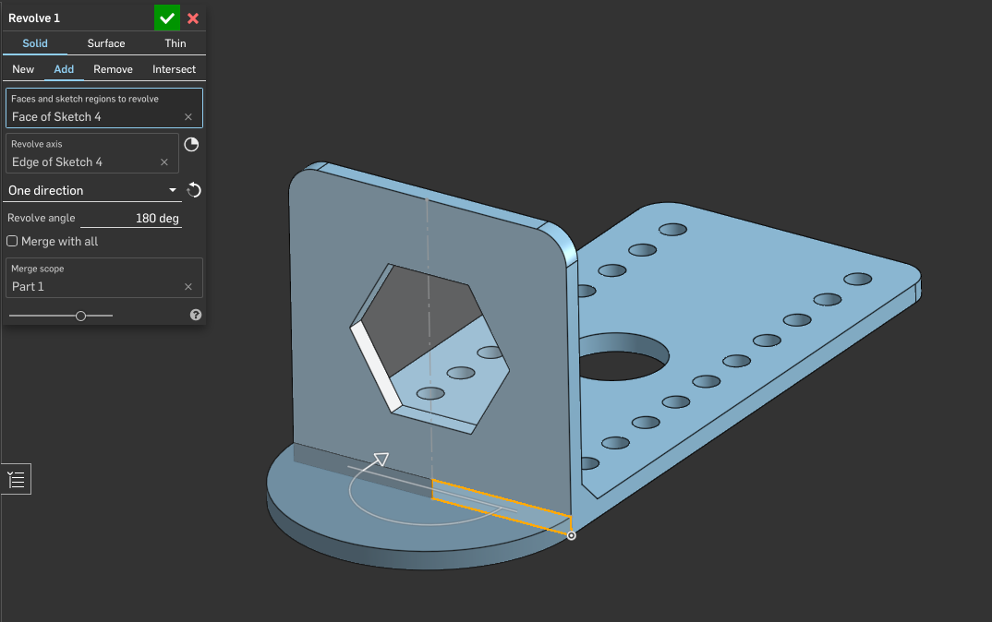
Revolve > Add > One Direction > 180 degrees
Revolve the rectangle 180 degrees to create a semi-cicle

Slide 47
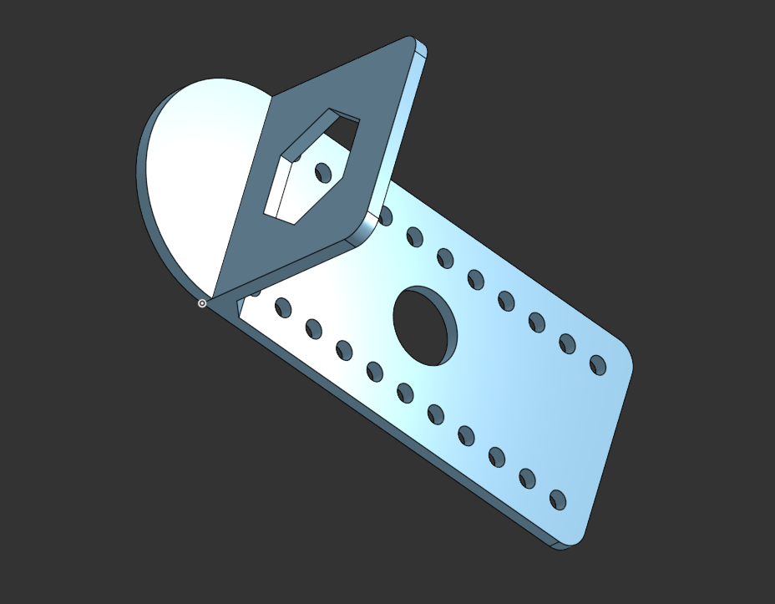
Revolve

